Slide 1
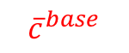
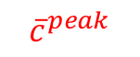
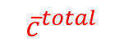
$${\overline{c}}^{total}$$
$${\overline{c}}^{peak}$$
F ⁺(g_{t})
Production at time (t+1)
g_{t}
Production (MWh/H)
F ⁻(g_{t})
$${\overline{c}}^{base}$$
Percentage of Production Greater than y-value (%)
Production at time (t)

Slide 2
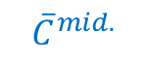

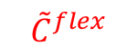
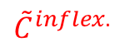


Production (MWh/H)
Percentage of Production Greater than y-value (%)
Production at time (t+1)
$${\overline{C}}^{mid.}$$
$${\overline{C}}^{mid.}$$
$${\tilde{C}}^{flex}$$
$${\tilde{C}}^{inflex.}$$
$${\overline{C}}^{inflex.}$$
$${\overline{C}}^{inflex.}$$
Production at time (t)

Slide 3
Generation Capacity by Fuel Type
Consumption profile
Market Simulation
Price (Determinate part)
Price (Stochastic part)
Trading volume
Flexible/ Inflexible Capacity
Revenue
Risk
Market Constraints
Objective Function
Constraints
Optimization
Cost
Technology Constraints
System State
Technology Simulation
System size (Number of EVs)

Slide 4
System Size (Number of EVs)
Historical price-volume data
Generation Time-Series by Fuel Type
Consumption Time-Series
Technology Simulation
Parameterization
Market Simulation
Mode Switch:
Actual / Simulated
System State
Price Signal
Volume Signal
Cost
Technology Constraints
Revenue
Market Constraints
Optimization
Objective Function
Constraints
Optimal operating plan
Legend
Technology-based modules
Revenue, Cost
Market-based modules
Optimization

Slide 5
Generation Time-Series by Fuel Type
Time series of non-dispatchable capacity (RES)
Consumption Time-Series
Historical price data
-
Flexibility Analysis on Generation Fleet
Time series of inflexible capacity
Time series of flexible capacity
Time series of peak capacity
Residual load
+
Merit-order model
Supply
Day-ahead
market data
Simulated price signals
-
Deviations of actual price to simulated merit-order price
Day-ahead/ intra-day/ balancing/ real-time market data
SARIMA model

Slide 6
Scenario generator
Time series of inflexible capacity
Time series of flexible capacity
Time series of peak capacity
Time series of RES capacity
Time series of consumption
-
+
Residual load
Merit-order model
Supply
Simulated price – determinant trend
Monte-Carlo Simulation
SARIMA model
Simulated price – stochastic movement
+
Final simulated price

